Slide 1

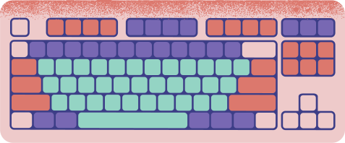











HANGMAN
VALERIE EVE TANIPUTRA
15 YEARS OLD
Hi

Slide 2



THe project
It is a recreation of hangman game. Where you have to guess the word that the random generator gave to you.

Slide 3



The LibRary

Slide 4

THIS IS THE LIBRARY THAT I USE

Slide 5


Demonstration
time

Slide 6


Concept

Slide 7

IT is a hangman game

Slide 8



Inspiration

Slide 9

it is the project i made for lesson 10

Slide 10
Thank you
Have a great evening

